Slide 1
Introduction to Deep Reinforcement Learning
From Theory to Applications
Siyi LI
HKUST
2017-06-11

Slide 2
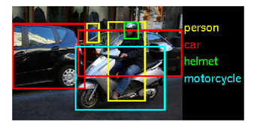


Background
Deep learning methods are making major advances in solving many low-level perceptual tasks.
See (visual object recognition)
Read (text understanding)
Hear (speech recognition)

Slide 3
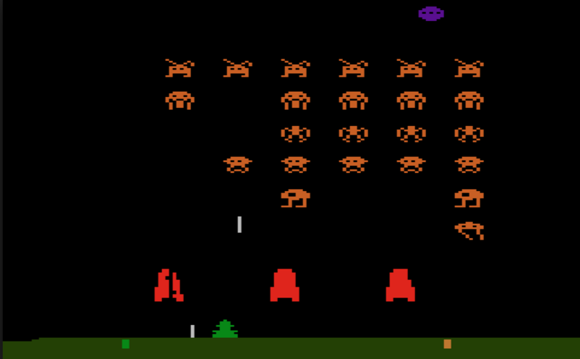
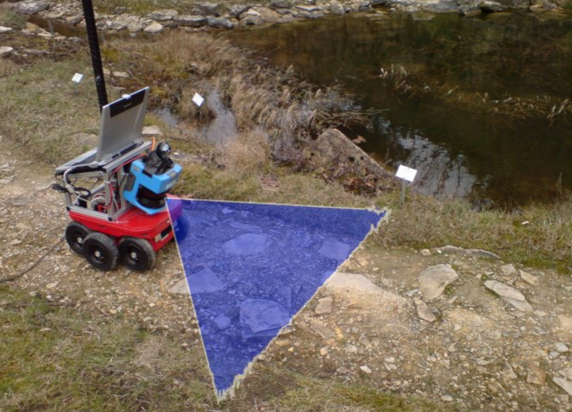
Background
More sophisticated tasks that involve decision and planning require a higher level of intelligence.
Real Artificial Intelligence system also requires the ability of reasoning, thinking and planning.
Playing Atari game
Robotic navigation

Slide 4
Limitations of Deep Learning
Supervised learning assumptions
Training and testing instances are i.i.d(independent and identically distributed) random variables
Training data are labeled data with strong supervision
Reality of most real-world tasks
Strong supervision is expensive and scarce
Sequential interactive process violates the i.i.d assumption

Slide 5
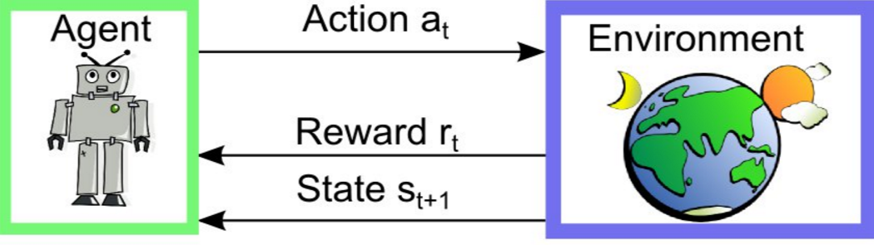
Reinforcement Learning (RL) in a nutshell
RL is a general-purpose framework for decision making
RL is for an agent to act with an environment
Each action influences the agent’s future state
Feedback is given by a scalar reward signal
Goal: select actions to maximize future reward

Slide 6
Deep RL: Deep Learning + RL
Traditional RL approaches have been limited to domains with low-dimensional state spaces or handcrafted features
By combining deep learning and RL, we want to embrace both the representation power of deep learning and generalization ability from RL
RL defines the objective
Deep Learning learns the representation

Slide 7
Outline
Introduction to Deep Learning
Introduction to Reinforcement Learning (RL)
Value-Based Deep RL
Policy-Based Deep RL
Other Deep RL Extensions
Deep RL Applications

Slide 8
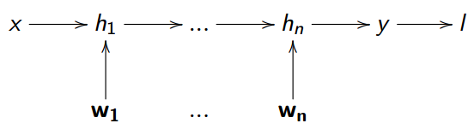
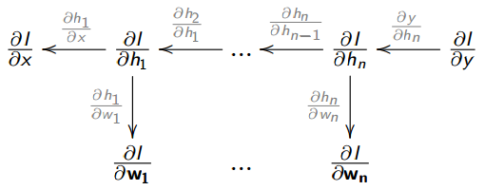
Deep Representations
A deep representation is a composition of many functions, where each composition level is learning feature representation at different level of abstraction
The weights are learned using backpropagation by chain rule

Slide 9
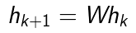
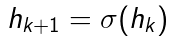
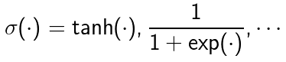
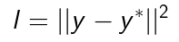
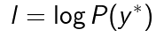
Deep Neural Network
A deep neural network typically consists of:
Linear transformations
Nonlinear activation functions
Loss function on the output
Mean squared error:
Log likelihood:

Slide 10
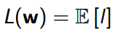
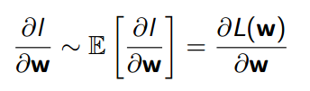
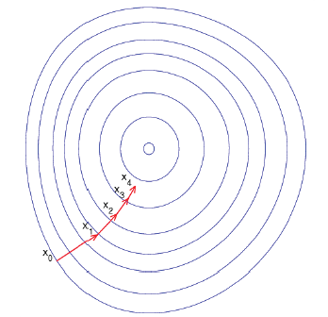
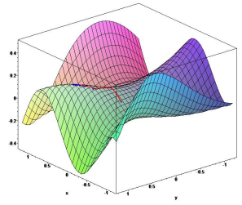
Training by Stochastic Gradient Descent
Sample gradient of expected loss (better efficiency for large data)
Adjust down the sampled gradient

Slide 11
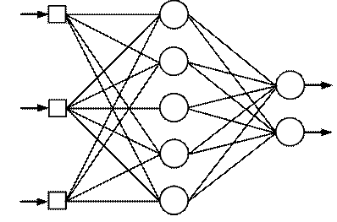
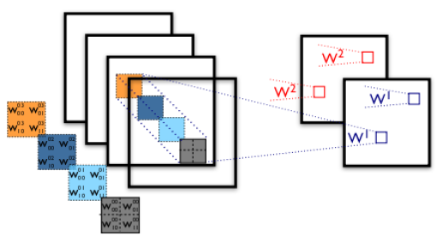
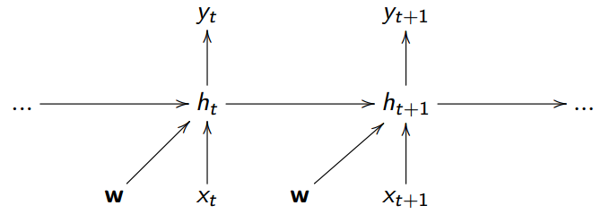
Deep Learning Models
Multilayer perceptrons (MLPs)
Fully-connected
Convolutional neural networks (CNNs)
Weight sharing between local regions
Recurrent neural networks (RNNs)
Weight sharing between time-steps

Slide 12
Outline
Introduction to Deep Learning
Introduction to Reinforcement Learning (RL)
Value-Based Deep RL
Policy-Based Deep RL
Other Deep RL Extensions
Deep RL Applications

Slide 13
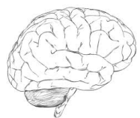
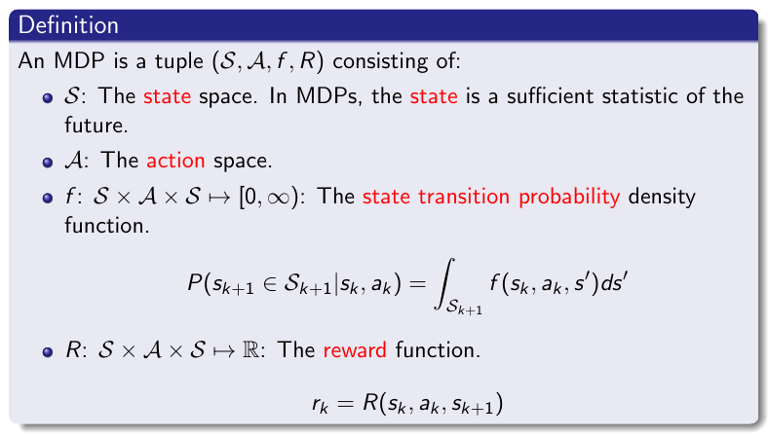




Markov Decision Processes (MDPs)
MDPs formally describe an environment for RL, where the environment is fully observable
state
action
$$s_{t}$$
$$a_{t}$$
$$r_{t}$$
reward

Slide 14
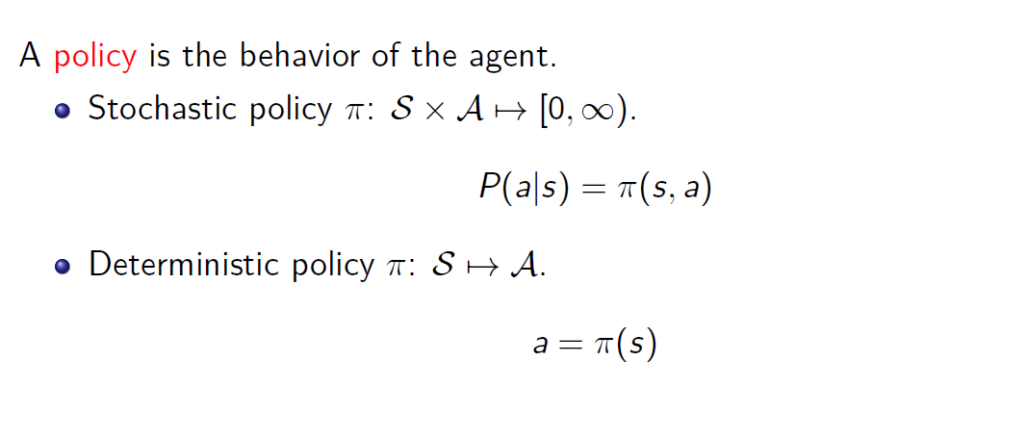
Policy

Slide 15
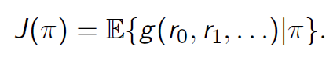
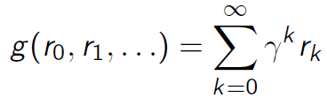
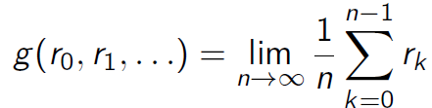
Expected Return
The goal of RL is to find the policy which maximizes the expected return
In most cases, the function g is either the discounted sum of rewards or the average reward
Discounted reward
Average reward

Slide 16
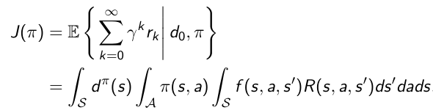
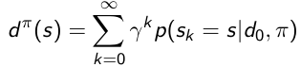
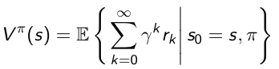
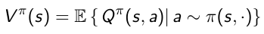
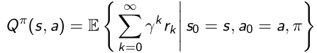
Value Function
Consider the discounted reward case
A value function is the prediction of the above expected return
Two definitions exist for the value function
State value function
State-action value function

Slide 17
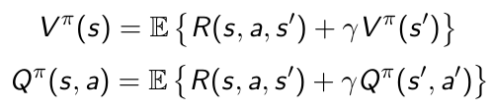
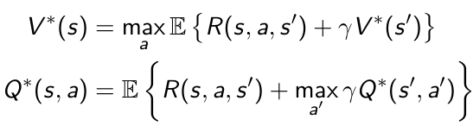
Bellman Equation and Optimality
Value functions decompose into Bellman equations, i.e., the value functions can be decomposed into immediate reward plus discounted value of successor state
An optimal value function is the maximum achievable value.
Optimality for value functions is governed by the Bellman optimality equations.

Slide 18
Approaches to RL
Critic-Only Methods
Learn value function
Implicit policy
Actor-Only Methods
No value function
Learnt policy
Actor-Critic Methods
Learn value function
Learn policy
Actor and critic are synonyms for the policy and value function.
Value Function
Policy
Actor-Critic
Critic-Only
Actor-Only

Slide 19
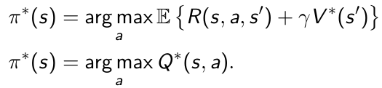
Critic-Only
A value function defines an optimal policy.
In critic-only methods, policy can be derived by selecting greedy actions
Finding optimal policy from state-action value function is direct.
Finding optimal policy from state value function is more complicated (requires the knowledge of transition model)

Slide 20
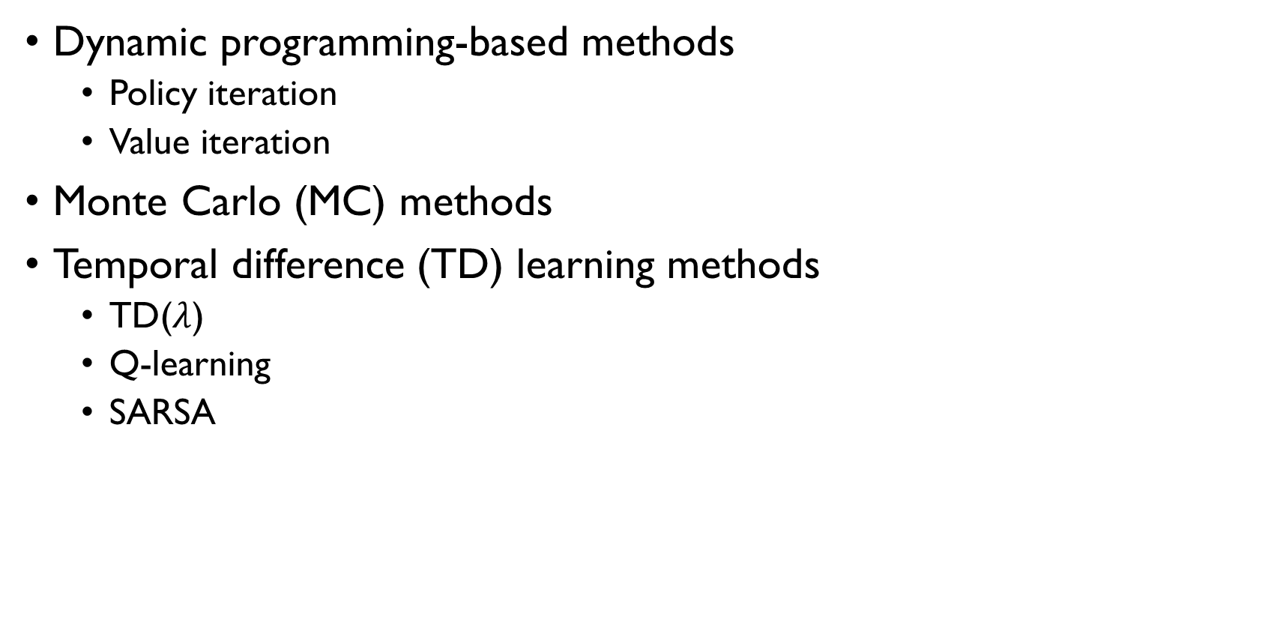
Critic-Only
Dynamic programming-based methods
Policy iteration
Value iteration
Monte Carlo (MC) methods
Temporal difference (TD) learning methods
TD($λ$)
Q-learning
SARSA

Slide 21
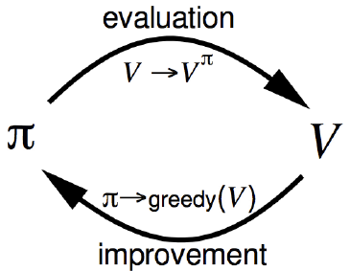
Dynamic Programming (DP)
DP methods require a model of the state transition density function f and the reward function R to calculate the state value function
DP is model-based
Policy evaluation: updates the value function for the current policy
Policy improvement: improve the policy by acting according to the current value function
Typical methods:
Policy iteration
Alternates between policy evaluation and policy improvement
Value iteration
No explicit policy
Directly update value function

Slide 22
Monte Carlo Methods
MC methods learn directly from episodes of experiences
MC is model-free: no knowledge of transitions/rewards
MC learns from complete episodes.
All episodes must terminate
MC uses simple idea: empirical mean return
The estimates are unbiased but have high variance.

Slide 23
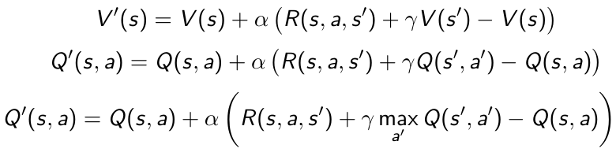
Temporal Difference (TD) Learning
TD methods learn directly from episodes of experiences
TD is model-free: no knowledge of transitions/rewards
TD learns from incomplete episodes, it can learn online after every step
TD uses temporal errors to update value function
The estimates are biased but have low variance.
SARSA
Q-learning

Slide 24
Actor-Only
Critic-only methods do not scale well to high-dimensional or continuous action spaces, since selecting greedy actions is computationally intensive.
Actor-only methods work with a parameterized family of policies over which optimization procedures can be used directly.
Advantages
Better convergence properties
Effective in high-dimensional or continuous action spaces
Can learn stochastic policies
Disadvantages
Evaluating a policy is inefficient and of high variance

Slide 25
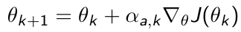
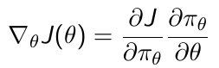
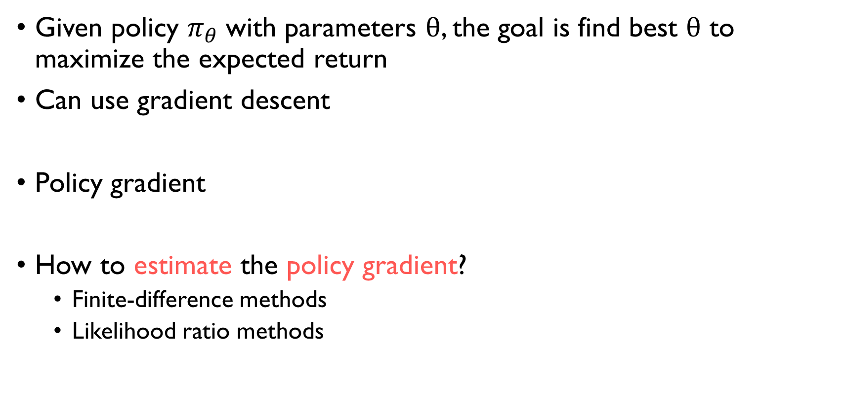
Policy Gradient
Given policy $π_{θ}$with parameters $θ$, the goal is find best $θ$ to maximize the expected return
Can use gradient descent
Policy gradient
How to estimate the policy gradient?
Finite-difference methods
Likelihood ratio methods

Slide 26
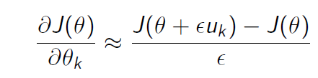
Finite-Difference Methods
Idea is simple, i.e., to vary the policy parameterization by small increments and evaluate the cost by rollouts
Estimate k-th partial derivative of object function
Simple, works even if policy is not differentiable
Noisy, inefficient

Slide 27
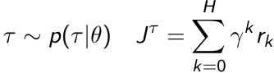
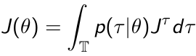
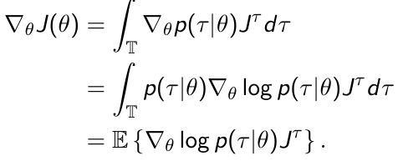
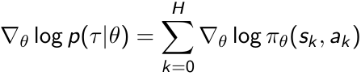
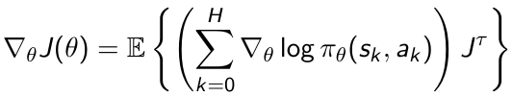
Likelihood Ratio Methods (REINFORCE)
We can formulate the expected return from the view of trajectories generated by rollouts
Use likelihood ratios to compute the policy gradient
Do not need to compute the system dynamics

Slide 28
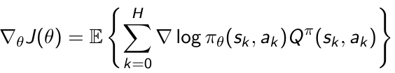
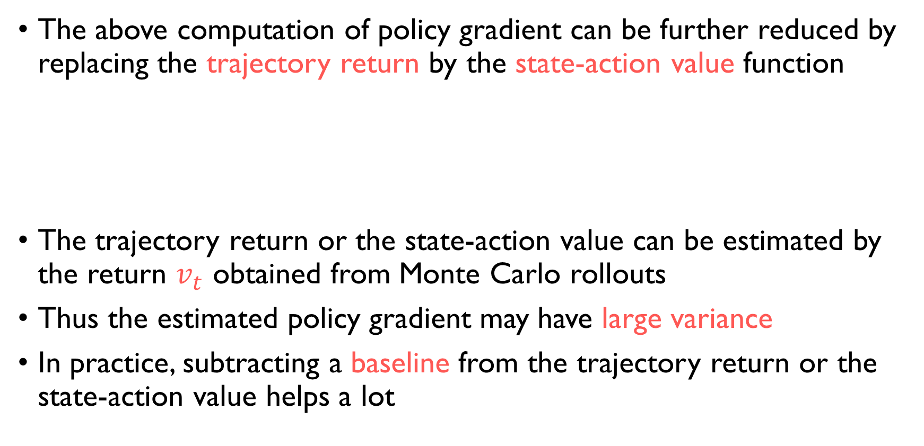
Likelihood Ratio Methods (REINFORCE)
The above computation of policy gradient can be further reduced by replacing the trajectory return by the state-action value function
The trajectory return or the state-action value can be estimated by the return $v_{t}$ obtained from Monte Carlo rollouts
Thus the estimated policy gradient may have large variance
In practice, subtracting a baseline from the trajectory return or the state-action value helps a lot

Slide 29
Actor-Critic
Critic-only
Pros: low variance
Cons: difficult for continuous action domains
Actor-only
Pros: easy to handle continuous actions
Cons: high variance
Actor-critic combines the advantages of actor-only and critic-only methods
Actions are generated by the parameterized actor
The critic supplies the actor with low variance gradient estimates

Slide 30
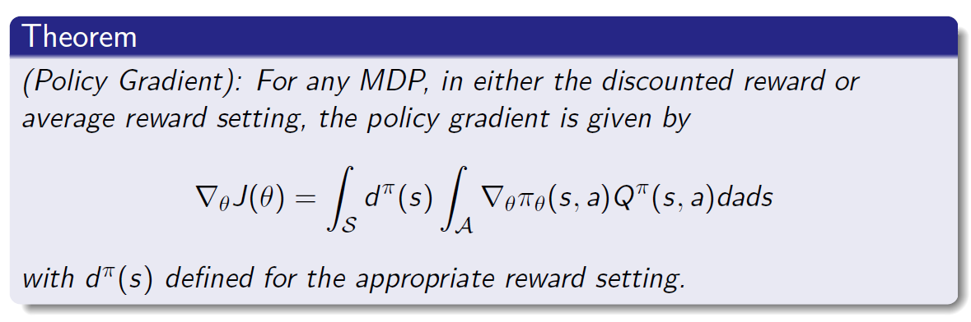
Policy Gradient Theorem
Actor-critic methods rely on the following policy gradient theorem
The above theorem shows the relationship between the policy gradient and the exact critic function.

Slide 31
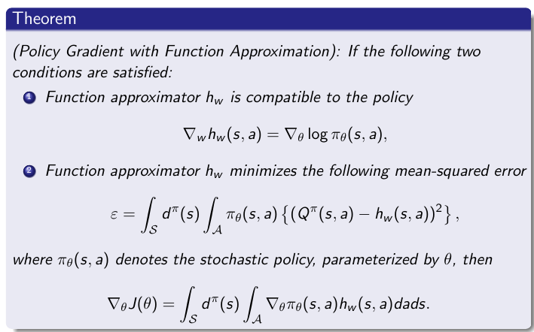
Policy Gradient With Function Approximation
The following theorem shows that the state-action value function can be approximated with a certain function, without affecting the unbiasedness of the policy gradient estimate

Slide 32
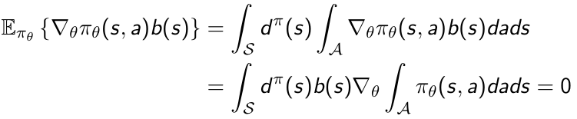
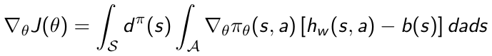

Reducing Variance Using a Baseline
The policy gradient theorem generalizes to the case where a state-dependent baseline function is taken into account. This can reduce variance, without changing expectation
A good baseline is the state value function
The policy gradient can be formulated by both the Q function and the advantage function

Slide 33

Standard Actor-Critic Algorithms
If both conditions in the above theorem are met, then the resulting algorithm is equivalent to the REINFORCE algorithm
Practical actor-critic algorithms often relax the second condition: use TD learning to update the critic approximator.
TD(0) actor-critic
The TD error is actually an estimate of the advantage function

Slide 34

Practical Actor-Critic Variants
The policy gradient has many equivalent forms

Slide 35


Natural Policy Gradient
The vanilla gradient is sensitive to policy parameterizations
The natural policy gradient is parameterization independent
It finds ascent direction that is closest to vanilla gradient, when changing policy by a small, fixed amount
Natural policy gradient methods converges faster in most practical cases. However, estimating the FIM may induce large computation cost
Fisher information matrix (FIM)

Slide 36


Natural Actor-Critic
Using compatible function approximation
The natural policy gradient is then

Slide 37
Deep Reinforcement Learning
Use deep neural networks to represent
Value function
Policy
Optimize loss function by stochastic gradient descent

Slide 38
Outline
Introduction to Deep Learning
Introduction to Reinforcement Learning (RL)
Value-Based Deep RL
Policy-Based Deep RL
Other Deep RL Extensions
Deep RL Applications

Slide 39








Q-Networks
Represent the state-action value function by Q-network with weights $w$

Slide 40


Q-Learning
Optimal Q-values obey Bellman equation
Treat right-hand size as a target and minimize MSE loss by SGD
Convergence guarantee using table lookup representation
But diverges using neural networks due to
Correlations between samples
Non-stationary targets

Slide 41



Deep Q-Networks (DQN)
Experience replay
Build data set from agent’s own experience
Sample experiences uniformly from data set to remove correlations
Target Network
To deal with non-stationarity, target parameters $\hat{w}$ are held fixed

Slide 42

Double DQN
Q-learning is known to overestimate state-action values
The max operator uses the same values to select and evaluate an action
The upward bias can be removed by decoupling the selection from the evaluation
Current Q-network is used to select actions
Older Q-network is used to evaluate actions

Slide 43



Prioritized Replay
Uniform experience replay samples transitions regardless of their significance
Can weight experiences according to their significance
Prioritized replay stores experiences in a priority queue according to the TD error
Use stochastic sampling to increase sample diversity

Slide 44




Dueling Network
Dueling network splits Q-network into two channels
Action-independent value function
Action-dependent advantage function
The two stream are aggregated to get the Q function

Slide 45

Deep Recurrent Q-Network (DRQN)
DQNs learn a mapping from a limited number of past states.
Most real world environments are Partially-Observable Markov Decision Processes (POMDPs)
DRQN replaces DQN’s first fully connected layer with a LSTM (one variant of RNN)

Slide 46

Asynchronous Q-Learning Variations
Asynchronous RL
Exploits multithreading of standard CPU
Execute many instances of agent in parallel
Parallelism decorrelates data
Thus an alternative to experience replay, which is memory inefficient
Network parameters shared between threads
Asynchronous one-step Q-learning
Asynchronous one-step SARSA
Asynchronous n-step Q-learning

Slide 47
Outline
Introduction to Deep Learning
Introduction to Reinforcement Learning (RL)
Value-Based Deep RL
Policy-Based Deep RL
Other Deep RL Extensions
Deep RL Applications

Slide 48


Asynchronous Advantage Actor-Critic (A3C)
Estimate state value function by neural networks
Q-value estimated by an n-step sample
Actor is updated by advantage policy gradient
Critic is updated by TD learning

Slide 49






Trust Region Policy Optimization (TRPO)
Formulated as a trust region optimization problem, where each update of the policy is guaranteed to improve
This provides a unifying perspective on a number of policy update schemes: standard policy gradient, natural policy gradient
First order approximation to the objective
Standard policy gradient
Natural policy gradient

Slide 50
Practical TRPO Algorithm
Use the same approximation schemes as the natural policy gradient
TRPO enforces the constraint by line search
Increases stability in practice
Use a conjugate gradient algorithm to compute the natural gradient direction
Makes it practical for deep neural network policies

Slide 51



Deep Deterministic Policy Gradient (DDPG)
Deterministic policy gradient
DDPG is the continuous analogue of DQN
Experience replay
Critic estimates value of current policy as in DQN
Actor updates policy in the deterministic policy gradient direction
The critic provides loss function for the actor

Slide 52
Outline
Introduction to Deep Learning
Introduction to Reinforcement Learning (RL)
Value-Based Deep RL
Policy-Based Deep RL
Other Deep RL Extensions
Deep RL Applications

Slide 53



Continuous Q-Learning
General Q function parameterizations are difficult to find the maximum
Specific Q function parameterizations can have analytic solution on the maximum
The action that maximizes the Q function is always
The parameterization can then be trained by DQN

Slide 54
Q-Learning with Model-Based Acceleration
Use model-based methods to generate exploration behavior for Q-learning
In practice it often brings very small or no improvement
Off-policy model-based exploration is too different from the Q learning policy
Imagination rollouts
Generate synthetic experiences under a learned model by model-based methods
Adding synthetic samples to replay buffer
Increases sample efficiency in practice

Slide 55


Guided Policy Search (GPS)
GPS converts policy search into supervised learning
Basically a model-based trajectory optimization algorithm generates training data for supervised learning where the neural network policy is trained by supervised learning
To enforce convergence, GPS alternates between trajectory optimization and supervised learning
GPS is data efficient

Slide 56
Outline
Introduction to Deep Learning
Introduction to Reinforcement Learning (RL)
Value-Based Deep RL
Policy-Based Deep RL
Other Deep RL Extensions
Deep RL Applications

Slide 57

Deep RL in Atari

Slide 58

DQN in Atari
End-to-end learning of state-action values from raw pixels
Input state is stack of raw pixels from last 4 frames
Output are state-action values from all possible actions
Reward is change in score for that step

Slide 59

DQN Results in Atari

Slide 60
DQN Demos in Atari
breakout
enduro

Slide 61

DQN Variants in Minecraft
Challenges in environments
Partial observability (first-person visual observations)
Delayed rewards
High-dimensional perception
Combine DQN with memory network to solve this kind of task

Slide 62

FPS Games
Visual Doom AI Competition
A DRQN Agent

Slide 63
Super Mario Games

Slide 64

Deep RL in Go
Use supervised learning followed by deep RL
Falls in the category of actor-critic framework
Use policy network to select moves
Use value network to evaluate board positions
The learning approach is further combined with Monte Carlo search
AlphaGo beats the human world champion

Slide 65



Deep RL for Classic Control Tasks
Simple tasks
Locomotion tasks
Hierarchical tasks
Suitable for benchmarking various algorithms

Slide 66

DDPG Demos for Classic Control

Slide 67


Deep RL in Real-World Robotics

